Slide 1

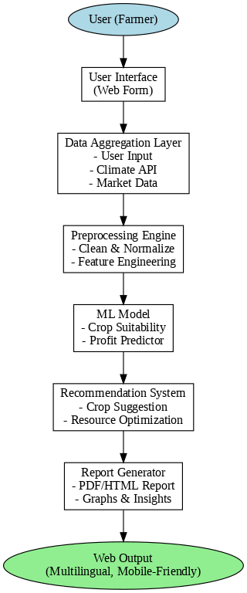
Proposed Architecture/ Diagram:
MIT SCHOOL OF COMPUTING
Class :FY-MSc AI/ML
Sr No : 3
DEPARTMENT OF COMPUTER SCIENCE & ENGINEERING
Agricultural Produce Predictor/Optimizer
Atharva Kangane
ADT24SOCM0103
Faculty Guide:-
Prof. Savitri Chaugule
What User says:-
"I need help choosing the best crop for my land."
"Market prices change, and I don't know what’s profitable."
What User thinks:-
"Farming decisions should be backed by data and predictions."
"If I grow the wrong crop, it could lead to a major loss."
Requirement | Proposed Functionality
Weather & Climate Integration | Auto-fetch or allow input of local weather data (via API or manual input).
Market Demand Analysis | Show current market prices/demand of crops from Maharashtra agri-data portal.
Crop Recommendation Engine | Predict most suitable crops using ML model based on user input and data.
Profit Estimator | Display estimated cost of production vs. expected income for each recommended crop.
Report Generator | Provide a downloadable summary report of the recommendation.
Responsive Design (Mobile-Friendly) | Ensure farmers can access the tool via smartphones or tablets easily.
User
What User Does:-
Tries to get advice from neighbors or local agricultural officers.
Visits local markets to understand current crop demand.
What User feels:-
Confused by climate changes and fluctuating prices.
Hopeful that AI and data-driven tools can make farming smarter.
Scope and Feasibility:-
Use real-time and historical data from Maharashtra Agricultural Produce Database
Technologies: Python, scikit-learn, Pandas, Flask, Plotly, etc.
Custom input interface for farmers
Visual crop recommendations with profit projections
Feasible using existing datasets and web frameworks
Problem statement :-
Farmers often struggle with identifying the most profitable and sustainable crop for their specific land. Factors like climate, soil quality, resource availability, market demand, and profit margins are complex to analyze manually..
Proposed Solution :-
Develop a predictive and optimization tool that uses AI/ML to:
Analyze field size, area, and climate
Factor in market demand and profitability
Consider resource availability and maintenance
Recommend the most suitable crop(s) to the farmer

